Slide 1
GLOBAL FACILITATOR
connecting buyers and sellers across continents for over five years
ALL-IN-ALL
IMPORT EXPORT
COMPANY ?
connecting buyers and sellers across continents for over five years
EXPERTISE LIES
connecting buyers and sellers across continents for over five years
ENSURES
EXCELLENCE OF EXECUTION !
GLOBAL BUSINESS GROUP
HEADQUARTERS, ADDIS ABABA, ETHIOPIA

Slide 2
ALL-IN-ALL
IMPORT EXPORT COMPANY
allinallglobalgroups.com
GLOBAL FACILITATOR
connecting buyers and sellers across continents for over five years
ALL-IN-ALL
IMPORT EXPORT
COMPANY ?
connecting buyers and sellers across continents for over five years
EXPERTISE LIES
connecting buyers and sellers across continents for over five years
© 2024 All in All Group. All rights reserved.
ENSURES
EXCELLENCE OF EXECUTION !
PAGE | 02
Your Trusted Partner in Global Trade
Building the World,
One Shipment at Time .

Slide 3
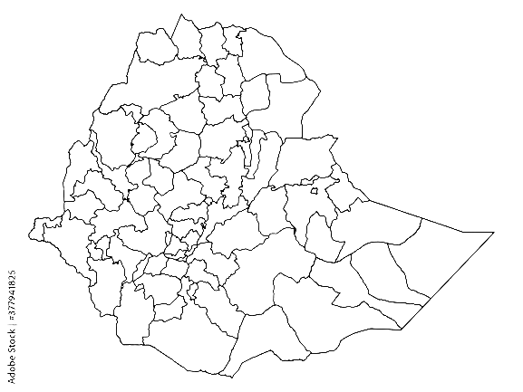
Unveiling Our Diverse Product Portfolio
allinallglobalgroups.com
ALL-IN-ALL
IMPORT EXPORT COMPANY
connecting buyers and sellers across continents for over five years
GLOBAL FACILITATOR
connecting buyers and sellers across continents for over five years
GLOBAL FACILITATOR
ALL-IN-ALL
IMPORT EXPORT
COMPANY ?
connecting buyers and sellers across continents for over five years
EXPERTISE LIES
connecting buyers and sellers across continents for over five years
EXPERTISE LIES
© 2024 All in All Group. All rights reserved.
connecting buyers and sellers across continents for over five years
ENSURES
connecting buyers and sellers across continents for over five years
Your Trusted Partner in Global Trade
Building the World,
One Shipment at Time .
ENSURES
ETHIOPIA
EXCELLENCE OF EXECUTION !
PAGE | 03
EXCELLENCE OF EXECUTION !

Slide 4
allinallglobalgroups.com
Unveiling Our Diverse Product Portfolio
BULK COMMODITIES
BULK COMMODITIES
Grains
Food oils
Fresh meat
Live stock
Coffee
Oil seeds
Sugar
Minerals
Fuels
Energy product
Human and Vet medicine
Laboratory equipment
HEAVY EQUIPMENT AND MACHINERY
© 2024 All in All Group. All rights reserved.
BUILDING MATERIALS
Tires
Machine trucks
Cement
Metal
Steel
Steel rebar
Timber
Aggregates Bitumen
ETHIOPIA
EXCELLENCE OF EXECUTION !
PAGE | 04
ALL-IN-ALL
IMPORT EXPORT COMPANY
Your Trusted Partner in Global Trade
Building the World,
One Shipment at Time .

Slide 5
allinallglobalgroups.com
COMMODITY TRADING :
BULK COMMODITIES
BULK COMMODITIES
Grains
Food oils
Fresh meat
Live stock
Coffee
Oil seeds
Sugar
Minerals
Fuels
Energy product
Human and Vet medicine
Laboratory equipment
We are the go-to source for a vast array of raw materials and resources. Imagine golden wheat fields, the lifeblood of nations, or the vital energy of coal powering industries. We source and supply these essentials, along with food oils, sugar, minerals, and fuels. Our market intelligence keeps us ahead of the curve, offering you competitive prices and flexible terms.
CORE BUSINESS AREAS
HEAVY EQUIPMENT AND MACHINERY
© 2024 All in All Group. All rights reserved.
BUILDING MATERIALS
Tires
Machine trucks
Cement
Metal
Steel
Steel rebar
Timber
Aggregates Bitumen
EXCELLENCE OF EXECUTION
PAGE | 05

Slide 6
allinallglobalgroups.com
BULK COMMODITIES
COMMODITY TRADING :
BULK COMMODITIES
CONSTRUCTION MATERIALS:
Grains
Food oils
Fresh meat
Live stock
Coffee
Oil seeds
Sugar
Minerals
Fuels
Energy product
Human and Vet medicine
Laboratory equipment
We are the go-to source for a vast array of raw materials and resources. Imagine golden wheat fields, the lifeblood of nations, or the vital energy of coal powering industries. We source and supply these essentials, along with food oils, sugar, minerals, and fuels. Our market intelligence keeps us ahead of the curve, offering you competitive prices and flexible terms.
Building the Future, Brick by Brick Our construction materials division takes pride in supplying the cornerstones of infrastructure. From the rock-solid foundation laid with our cement to the unyielding steel rebar that forms the skeleton of structures, we provide high-quality bricks, pipes, and construction equipment. We collaborate closely with manufacturers and construction firms, ensuring they have the
Right materials at the right time.
HEAVY EQUIPMENT AND MACHINERY
© 2024 All in All Group. All rights reserved.
BUILDING MATERIALS
Tires
Machine trucks
Cement
Metal
Steel
Steel rebar
Timber
Aggregates Bitumen
EXCELLENCE OF EXECUTION
PAGE | 06

Slide 7
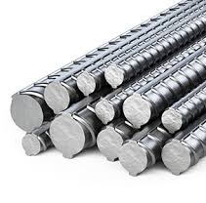
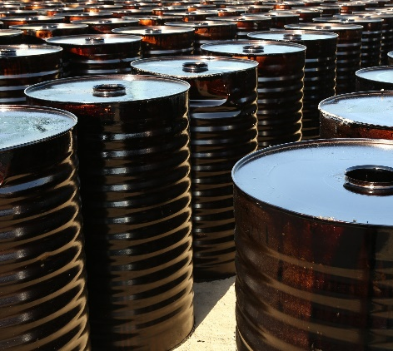
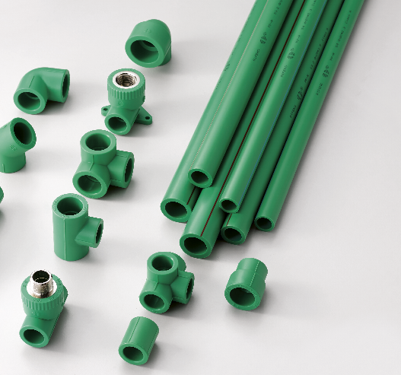
allinallglobalgroups.com
LOGISTICS AND SUPPLY CHAIN MANAGEMENT:
CONSTRUCTION MATERIALS:
Seamless Delivery from Source to Site Our expertise extends beyond trading. We offer a complete suite of logistics solutions that streamline the journey of your goods. Our network of partners handles everything from freight forwarding and customs clearance to warehousing and door-to-door delivery. Imagine your shipment navigating complex borders with ease, arriving exactly when and where you need it.
Building the Future, Brick by Brick Our construction materials division takes pride in supplying the cornerstones of infrastructure. From the rock-solid foundation laid with our cement to the unyielding steel rebar that forms the skeleton of structures, we provide high-quality bricks, pipes, and construction equipment. We collaborate closely with manufacturers and construction firms, ensuring they have the
Right materials at the right time.
© 2024 All in All Group. All rights reserved.
EXCELLENCE OF EXECUTION
PAGE | 07

Slide 8
MARKET INTELLIGENCE AND ADVISORY
Knowledge is Power In today's dynamic market, informed decisions are paramount. Our team of industry experts provides invaluable market insights – think informed forecasts and strategic advice – empowering you to seize opportunities and navigate challenges
allinallglobalgroups.com
LOGISTICS AND SUPPLY CHAIN MANAGEMENT:
Seamless Delivery from Source to Site Our expertise extends beyond trading. We offer a complete suite of logistics solutions that streamline the journey of your goods. Our network of partners handles everything from freight forwarding and customs clearance to warehousing and door-to-door delivery. Imagine your shipment navigating complex borders with ease, arriving exactly when and where you need it.
© 2024 All in All Group. All rights reserved.
EXCELLENCE OF EXECUTION
PAGE | 08

Slide 9
Our large trading volume and established market presence translate into competitive pricing,
giving you a clear edge
We don't believe in a one-size-fits-all approach. Our logistics solutions are customized to fit your specific requirements,
ensuring a smooth and efficient flow of goods.
Your Peace of Mind is Our Priority We have implemented robust risk management and quality control
processes, so you can rest assured that your shipment arrives exactly as specified.
We've built long-standing partnerships with leading manufacturers and producers, guaranteeing you reliable access
to top-quality products.
We have a vast network of suppliers and customers, spanning continents and ensuring you find the best deals
in key markets
allinallglobalgroups.com
MARKET INTELLIGENCE AND ADVISORY
GLOBAL FACILITATOR
connecting buyers and sellers across continents for over five years
Knowledge is Power In today's dynamic market, informed decisions are paramount. Our team of industry experts provides invaluable market insights – think informed forecasts and strategic advice – empowering you to seize opportunities and navigate challenges
connecting buyers and sellers across continents for over five years
EXPERTISE LIES
© 2024 All in All Group. All rights reserved.
connecting buyers and sellers across continents for over five years
ENSURES
EXCELLENCE OF EXECUTION
PAGE | 09
LOGISTICS AND SUPPLY CHAIN MANAGEMENT:
Seamless Delivery from Source to Site Our expertise extends beyond trading. We offer a complete suite of logistics solutions that streamline the journey of your goods. Our network of partners handles everything from freight forwarding and customs clearance to warehousing and door-to-door delivery. Imagine your shipment navigating complex borders with ease, arriving exactly when and where you need it.

Slide 10
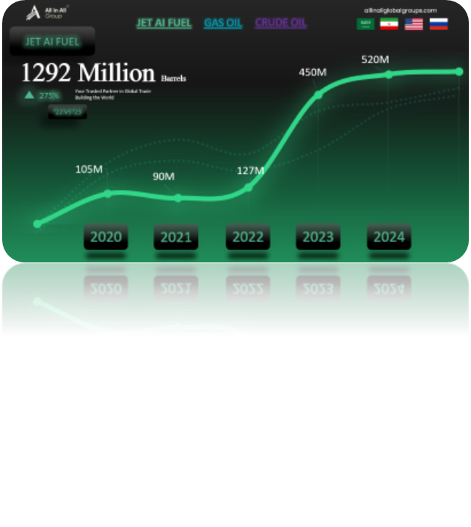
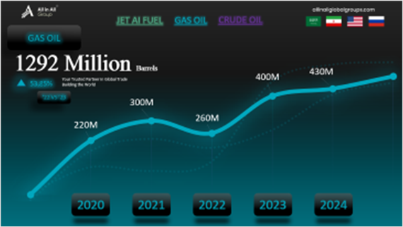
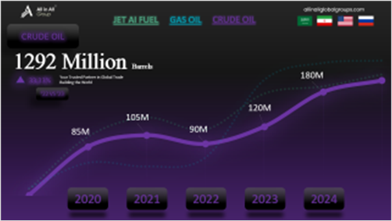
allinallglobalgroups.com
WHY
PARTNER WITH
ALL-IN-ALL IMPORT EXPORT?
We are more than just a trading company;
we are your trusted partner in the ever-evolving world of global trade.
GLOBAL REACH, LOCAL TOUCH
ROCK-SOLID RELATIONSHIPS
RISK MANAGEMENT & QUALITY CONTROL
TAILOR-MADE SOLUTIONS
COMPETITIVE ADVANTAGE THROUGH VOLUME & INFLUENCE
We have a vast network of suppliers and customers, spanning continents and ensuring you find the best deals
in key markets
We've built long-standing partnerships with leading manufacturers and producers, guaranteeing you reliable access
to top-quality products.
Your Peace of Mind is Our Priority We have implemented robust risk management and quality control
processes, so you can rest assured that your shipment arrives exactly as specified.
We don't believe in a one-size-fits-all approach. Our logistics solutions are customized to fit your specific requirements,
ensuring a smooth and efficient flow of goods.
Our large trading volume and established market presence translate into competitive pricing,
giving you a clear edge
Let us discuss how we can help you navigate the complexities of import and export,
unlocking new opportunities and propelling your business forward.
© 2024 All in All Group. All rights reserved.
EXCELLENCE OF EXECUTION
PAGE | 10
MARKET INTELLIGENCE AND ADVISORY
Knowledge is Power In today's dynamic market, informed decisions are paramount. Our team of industry experts provides invaluable market insights – think informed forecasts and strategic advice – empowering you to seize opportunities and navigate challenges

Slide 11
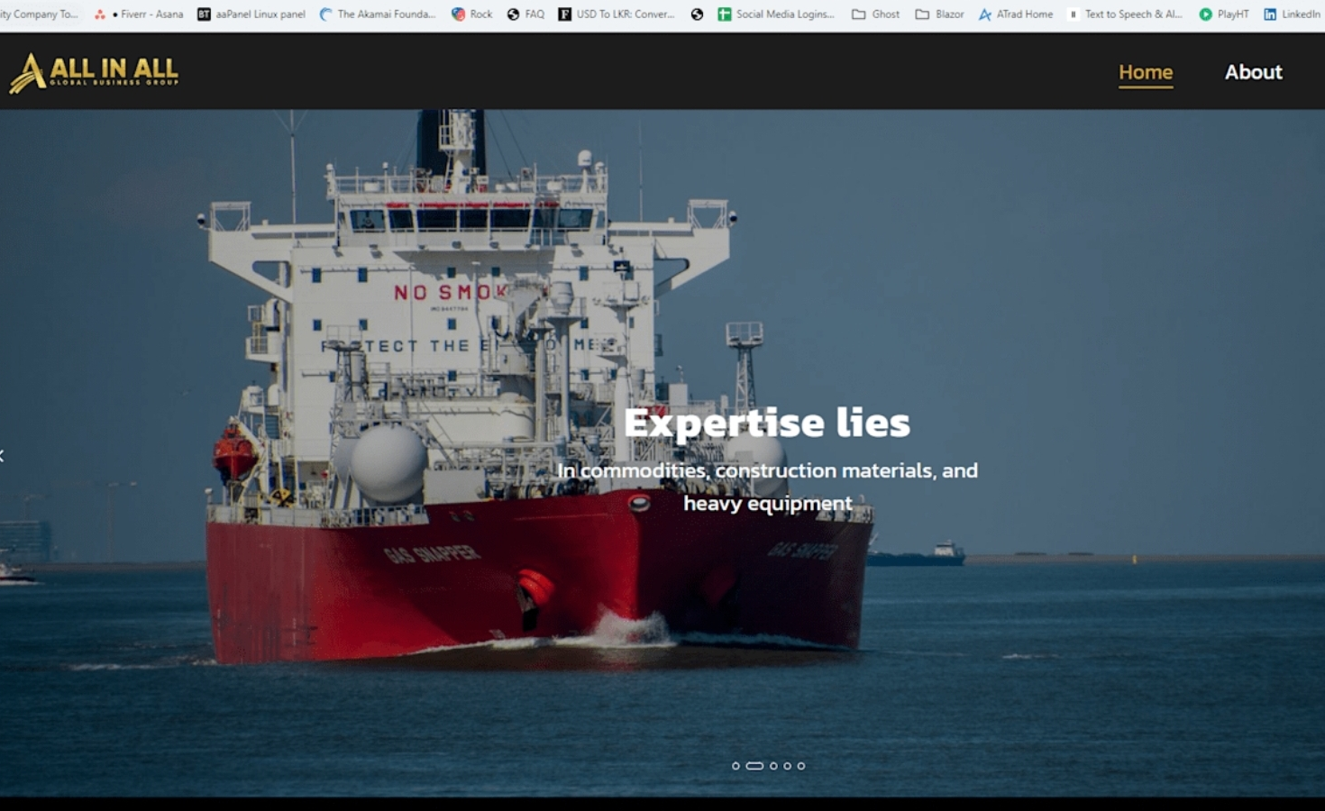
allinallglobalgroups.com
PETROLEUM SUPPLY CHAIN
MARKET/PRODUCT GRID
Our large trading volume and established market presence translate into competitive pricing,
giving you a clear edge
We don't believe in a one-size-fits-all approach. Our logistics solutions are customized to fit your specific requirements,
ensuring a smooth and efficient flow of goods.
Your Peace of Mind is Our Priority We have implemented robust risk management and quality control
processes, so you can rest assured that your shipment arrives exactly as specified.
We've built long-standing partnerships with leading manufacturers and producers, guaranteeing you reliable access
to top-quality products.
We have a vast network of suppliers and customers, spanning continents and ensuring you find the best deals
in key markets

Slide 12
allinallglobalgroups.com
We are a global business group specializing in the supply of crude oil, petroleum, fuel, gas oil, and j a1 aviation fuels to the east and west african markets.
As a major supplier, we source directly from producers to offer competitive pricing and reliable on-time deliveries. With a proven track record of five years of exceptional service, we invite you to choose us for all your fuel needs.
Our large trading volume and established market presence translate into competitive pricing,
giving you a clear edge
We don't believe in a one-size-fits-all approach. Our logistics solutions are customized to fit your specific requirements,
ensuring a smooth and efficient flow of goods.
Your Peace of Mind is Our Priority We have implemented robust risk management and quality control
processes, so you can rest assured that your shipment arrives exactly as specified.
We've built long-standing partnerships with leading manufacturers and producers, guaranteeing you reliable access
to top-quality products.
We have a vast network of suppliers and customers, spanning continents and ensuring you find the best deals
in key markets

Slide 13
allinallglobalgroups.com
Our large trading volume and established market presence translate into competitive pricing,
giving you a clear edge
We don't believe in a one-size-fits-all approach. Our logistics solutions are customized to fit your specific requirements,
ensuring a smooth and efficient flow of goods.
Your Peace of Mind is Our Priority We have implemented robust risk management and quality control
processes, so you can rest assured that your shipment arrives exactly as specified.
We've built long-standing partnerships with leading manufacturers and producers, guaranteeing you reliable access
to top-quality products.
We have a vast network of suppliers and customers, spanning continents and ensuring you find the best deals
in key markets

Slide 14
allinallglobalgroups.com
JET AI FUEL
GAS OIL
CRUDE OIL
JET AI FUEL
1292 Million Barrels
275%
Your Trusted Partner in Global Trade
Building the World
‘22 VS ‘23
75.1$ per BARREL
2020
2021
2022
2023
2024

Slide 15
2023 SALES
$ 345,612
79.51%
This presentation was made by Upendra Saumyajith Adikari
VS 2022
allinallglobalgroups.com
JET AI FUEL
GAS OIL
CRUDE OIL
GAS OIL
1610 Million Barrels
53.85%
Your Trusted Partner in Global Trade
Building the World
‘22 VS ‘23
2.33$ per BARREL
2020
2021
2022
2023
2024

Slide 16
2023 SALES
2022 SALES
$ 345,612
$ 126,631
79.51%
This presentation was made by Upendra Saumyajith Adikari
58.75%
This presentation was made by Upendra Saumyajith Adikari
VS 2022
VS 2021
allinallglobalgroups.com
JET AI FUEL
GAS OIL
CRUDE OIL
CRUDE OIL
580 Million Barrels
33.33%
Your Trusted Partner in Global Trade
Building the World
‘22 VS ‘23
77.2$ per BARREL
2020
2021
2022
2023
2024

Slide 17
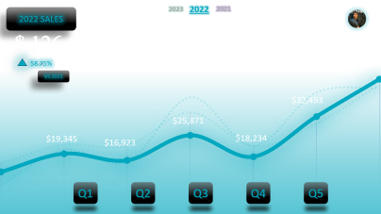
allinallglobalgroups.com

Slide 18
allinallglobalgroups.com

Slide 19
allinallglobalgroups.com

Slide 20
allinallglobalgroups.com

Slide 21
allinallglobalgroups.com
GLOBAL FACILITATOR
connecting buyers and sellers across continents for over five years
We are more than just a trading company;
we are your trusted partner in the ever-evolving world of global trade.
LET'S BUILD SOMETHING EXTRAORDINARY TOGETHER
connecting buyers and sellers across continents for over five years
EXPERTISE LIES
Let us discuss how we can help you navigate the complexities of import and export,
unlocking new opportunities and propelling your business forward.
© 2024 All in All Group. All rights reserved.
connecting buyers and sellers across continents for over five years
ENSURES
AIA IMPORT EXPORT COMPANY
EXCELLENCE OF EXECUTION
PAGE | 16
Our large trading volume and established market presence translate into competitive pricing,
giving you a clear edge
We don't believe in a one-size-fits-all approach. Our logistics solutions are customized to fit your specific requirements,
ensuring a smooth and efficient flow of goods.
Your Peace of Mind is Our Priority We have implemented robust risk management and quality control
processes, so you can rest assured that your shipment arrives exactly as specified.
We've built long-standing partnerships with leading manufacturers and producers, guaranteeing you reliable access
to top-quality products.
We have a vast network of suppliers and customers, spanning continents and ensuring you find the best deals
in key markets

Slide 22
allinallglobalgroups.com
CONTACT US
TODAY
connecting buyers and sellers across continents for over five years
GLOBAL FACILITATOR
We are more than just a trading company;
we are your trusted partner in the ever-evolving world of global trade.
LET'S BUILD SOMETHING EXTRAORDINARY TOGETHER
ADDRESS
connecting buyers and sellers across continents for over five years
LONDON W12 UNITED KINGDOM | ADDIS ABABA BOLE ETHIOPIA
Let us discuss how we can help you navigate the complexities of import and export,
unlocking new opportunities and propelling your business forward.
PHONE
+447494987777
| +251777010701 (ETH)
© 2024 All in All Group. All rights reserved.
connecting buyers and sellers across continents for over five years
EMAIL
ENSURES
AIA IMPORT EXPORT COMPANY
services@allinallglobalgroups.com
WEBSITE
allinallglobalgroups.com
EXCELLENCE OF EXECUTION
PAGE | 17

Slide 23
allinallglobalgroups.com
GLOBAL FACILITATOR
connecting buyers and sellers across continents for over five years
EXCELLENCE OF
EXECUTION
connecting buyers and sellers across continents for over five years
EXPERTISE LIES
© 2024 All in All Group. All rights reserved.
connecting buyers and sellers across continents for over five years
ENSURES
IS OUR MOTTO
EXCELLENCE OF EXECUTION
PAGE | 18

